Slide 1
Sentiment Analysis on COVID-related Tweets Using Data Mining Techniques
08/2022
Group Name: Neem
Group member: Chia-wei Lin, Yuanzhi Xu, Wen Xie
Notes:
Hello everyone. We are Group Neem. Our project is a sentiment analysis on Covid-related Tweets, with Data Mining techniques applied.

Slide 2
What is the project about
Methodology
Walk through codes
Results
Discussion
Future work
Conclusion
Notes:
This presentation will mainly covers the following contents. First, what the project is and the methodology used. Then we will walk through codes to get the result. Discussion about the result and future work will be provided. And finally we will arrive at our conclusion.

Slide 3
What is the project about
User-generated content (UGC) on social media platforms
-> user opinion tracking
Sentiment analysis
-> provide an edge for businesses and governments
Covid and Tweets
Sentiment Analysis on COVID-related Tweets Using Data Mining Techniques
Importance
Notes:
The proliferation of user-generated content (UGC) on social media platforms has made user opinion tracking a strenuous job.
Twitter, being a huge microblogging social network, provides a platform for people to share and express their views towards topics, happenings, products and other services. And it could be used to accumulate views about the above mentioned aspects. In fact, it has been used extensively for public health surveillance.
Sentiment analysis is a mining technique employed to peruse opinions, emotions, and attitude of people toward any subject. The results could be wielded to provide an edge for businesses and governments in rolling out new entities (policies, products, topic, event).
Commencing on January, 2020, the Covid-19 pandemic has been placing great impact upon people’s life all over the world. Economy, politics, infrastructure, medical service, and culture are all under great influence.
This project contains implementation of data mining, machine learning, and natural language processing techniques, trains models on a labeled Tweets dataset, then applies the best-performing model to a public twitter dataset which captured COVID-19 related tweets posted on four Fridays in Feb 2022, and thus proposes a sentiment analysis approach to classify the Tweets into positive and negative categories.
This study is of great importance. Covid-19 has been prevailing for such a long time and it has brought in such a lot of influence. Government and organizations have been taking actions such as lock down, isolation, heath monitoring, work from home, etc. When making a decision on whether to lay or lift a requirement, the public's attitude is a factor of great weight. Sentiment analysis can provide critical information about communities’ risk perceptions. This project would help government and organizations to identify public sentiment towards certain words or topics, and in turn aids them to roll out new entities.

Slide 4
Methodology
Data preparation for the train set
Obtain the best word vector
Develop the best model
Apply model to real world Tweets
Analyze results
Notes:
The project is done by the following steps:
First, Data preparation for the train dataset; and then obtain the best word vector to represent the content mathematically, and then develop the best model, apply model to real world Tweets, and finally get the results and do analysis.

Slide 5
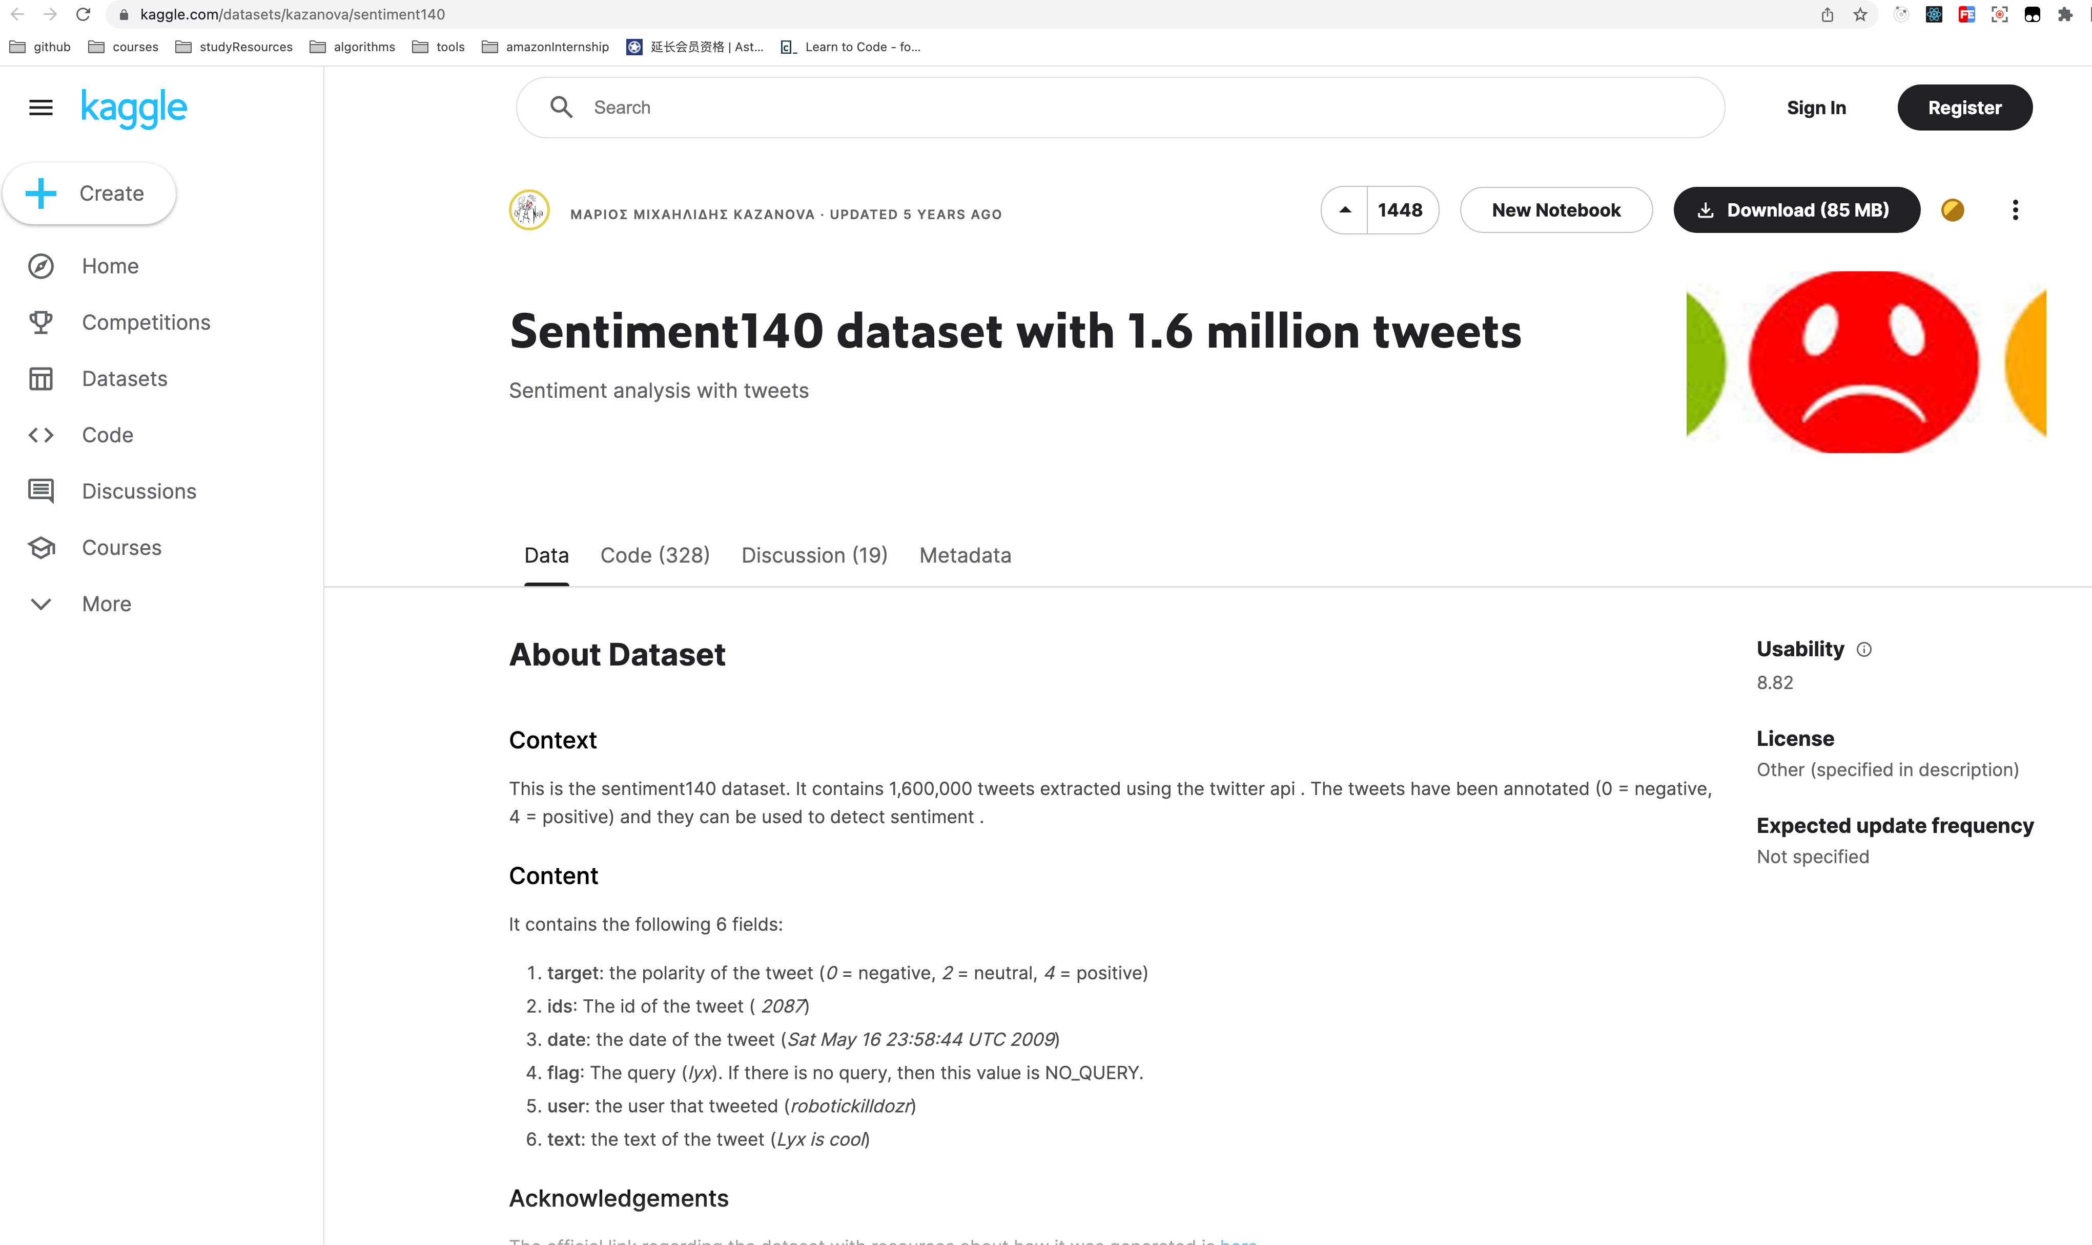
Read and preprocess data
Dataset: Sentiment140 dataset with 1.6 million tweets: https://www.kaggle.com/datasets/kazanova/sentiment140
Notes:
The project uses a dataset from Kaggle. This dataset contains 1.6 million tweets extracted using the twitter api.

Slide 6
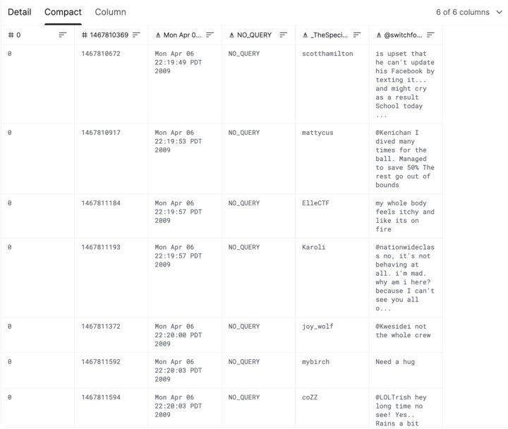
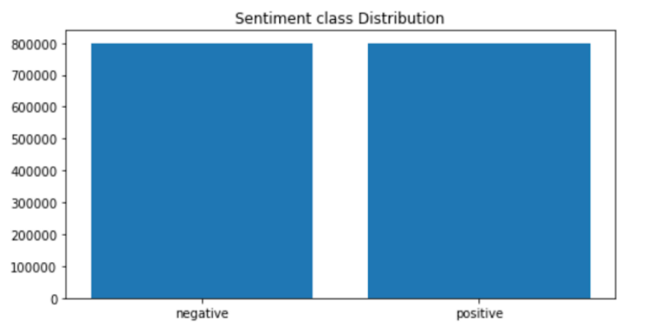
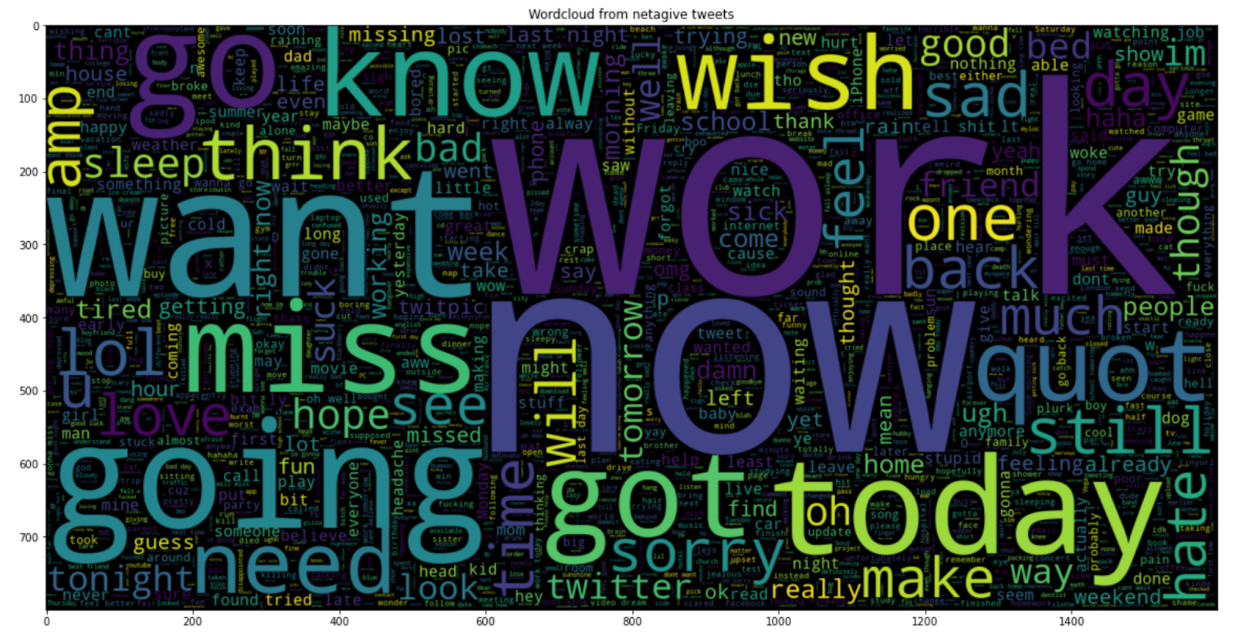
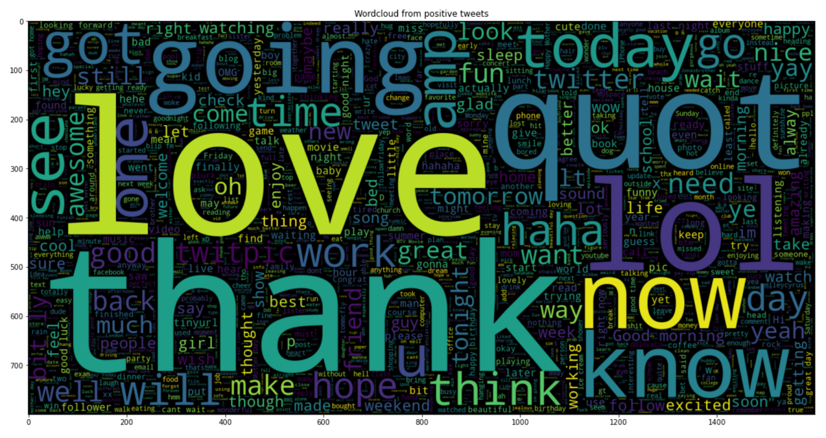
Notes:
The tweets have been annotated (0 = negative, 4 = positive) and they can be used to detect sentiment. This dataset is used as the train dataset since it is clean, balanced, and already has target value labeled.

Slide 7

Yield the best word vector
to mathematically represent the dataset
gloVe embedding
Unigram count vectorizor
bigram count vectorizer
tf-idf unigram vectorizer
tf-idf bigram vectorizer
unigram tf-idf vectorizer performs best
Bernoulli model
Notes:
5 word vectorizer are used with Bernoulli model in order to generate the best word vectorizer that can mathematically represent the dataset. It turns out unigram tf-idf vectorizer is the best.

Slide 8
Create and compare models
2 existing Tweets sentiment analyzing tools：
logistic regression
BernoulliNB
random forest
SVM
Xgboost
nltk sentiment analyzer
textblob
Unigram tf-idf vectorizer
Notes:
Then, the project develops 5 models to interpret and classify sentiment on the dataset with pre-selected vectorizer. It turns out that BernoulliNB model has the best performance. Also, 2 existing Tweets sentiment analyzing tools are introduced to test the performance of the model trained by the project. Results show that our model has better performance than existing tools.

Slide 9
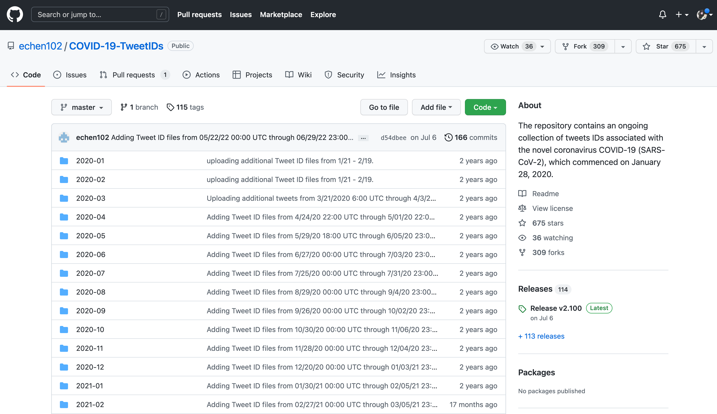
Apply the best model to real world data
https://github.com/echen102/COVID-19-TweetIDs
Notes:
With this selected model, the project investigates the sentiment of Tweets of all Fridays in February 2022. The real world data is collected from this repo.

Slide 10
Walk through codes
Notes:
Let's walk through codes to get detailed idea.

Slide 11
Discussion
Model performance
Sentiment analysis result
the positive and negative sentiments are not observably unequal in the 4 specific days in 02/2022
A balance between prediction accuracy and time consumed
the accuracy rate this project achieved is not high
The model trained by the project outperforms the existing tools
Notes:
Let's discuss what we have found.
1. Data analysis shows that the positive and negative sentiments are not observably unequal in the 4 specific Fridays in 02/2022. Negative takes a minor more distribution. This indicates that the public are not extremely anxious, but also not absolutely optimistic towards Covid-19.
2. There has not been a huge difference among various vectors and models, however, the time consuming is of great difference. A balance between prediction accuracy and time consumed should be maintained in data analysis works.
3. From the perspective of natural language processing, the accuracy rate this project achieved is not high. The comparatively low accuracy is caused by the nature of Tweets: short expressions not containing much meaningful information. Even a human being sometimes will find it hard to detect the sentiment of a certain Tweet.
4. The model trained by the project outperforms the existing tools. One possible explanation would be the project merely chooses Tweets as the content rather than a comprehensive corpus source.

Slide 12
Future work
More comprehensive approach to pick the best vector
Longer time duration for Tweets data
Tune the model
Involve more content source platforms
Notes:
First, due to time and resource limits, the best model developed in this project is based on is chosen upon BernoulliNB model. To make the model more accurate and predictive, more models should be applied when deciding the word vector. The best scenario would be picking the best vector together with the best model among all combinations of the 3 vectors and 5 models.
Second, obtaining real world Tweets and the pre-processing of these Tweets is time consuming and effort demanding. Given limited time for this study, with the purpose of controlling dataset size, this study chose to limit the source data, the real world tweets, to specific days in Feb 2022. And the insights generated CAN reflect the public's attitude within this restricted time, but it can not reflect the trend of attitude during the entire, long period since the pandemic began in 2020. Further research that covers tweets from 2020 will help a lot to generate the attitude trend, and in turn offer more thorough and persuasive conclusions.
Third, the model could be fine-tuned by parameter adjustment, or even, a neural network model could be employed to understand the meaning of a full sentence rather than simply analyze the word in the sentence and then classify the sentiment of the Tweet. Better model and more comprehensive approach would most probably render more convincing results.
Last but not least, this project selected Twitter to be the content source. There are many other content sources which are also popular and can stand for people’s sentiment from some perspective, for example: Reddit, FaceBook, Blind, etc. Simply using content from one social media platform is not strong enough to speak for the entire public. More content sources should be involved and a more comprehensive result would be given.

Slide 13
Conclusion
under BernoulliNB model with bigram tf-idf vectorizer, among 174,660 Tweets, 51.02% (89,113) are negative, and 48.98% (85,547) are positive. On each particular day investigated, no observable difference is detected on the ratio of negative sentiment to positive sentiment.
A more comprehensive approach could be used to select the best word vector. A better model would be gained by tuning the parameter of the model during the training process. A neural network model could be employed to understand the meaning of a full sentence.
To offer a better public attitude report to the government or organizations
Notes:
So, to summarize, from the analysis done by this project, we know that,
sentiment of Tweets of Feb 4th, Feb 11th, Feb 18th, and Feb 25th, 2022, no observable difference is detected on the ratio of negative sentiment to positive sentiment.
To make the prediction more accurate, a more comprehensive approach could be used to select the best word vector.
A better model would be gained by tuning the parameter of the model during the training process.
A neural network model could be employed to understand the meaning of a full sentence.
To offer a better public attitude report to the government or organizations, a larger real world dataset would aid in showing the trend of the public sentiment rather than currently the 4 specific days’ result. More public voices from diverse social media platforms should be included instead of solely using Tweets.

Slide 14
Thank you!
Notes:
Thanks for watching. Best luck to everyone.

